Slide 1
Lookup Highschool Test Scores
Group 9

Slide 2
Group 9 Member
ID | Name
6151071065 | Nguyen Thanh Liem
6151071008 | Nguyen Thi Van Khanh
6151071077 | Le Thanh Nhan
6151071083 | Tran Thien Phu
6151071021 | Ha Diem Quynh
6151071108 | Le Ba Khanh Trinh

Slide 3
TABLE OF CONTENTS
01
02
03
04
INTRODUCE
MAIN CONTENT
RESULTS
CONCLUSIONS

Slide 4
INTRODUCTION
We’ve been working for 30 days for this project
Set up idea less than 7 days

Slide 5
MAIN CONTENT
We using:
-Oracle Database, SpringBoot
-ReactJS-SCSS
-Our Logic and Knowledge

Slide 6
01
02
Database - BE
FE

Slide 7
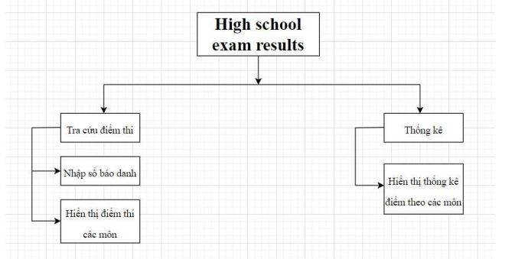
BFD

Slide 8
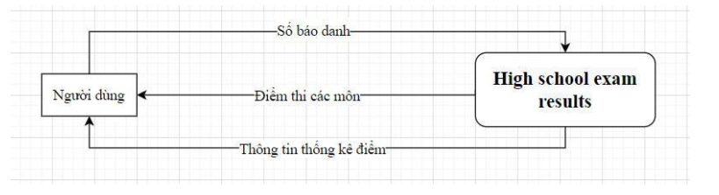
DFD

Slide 9
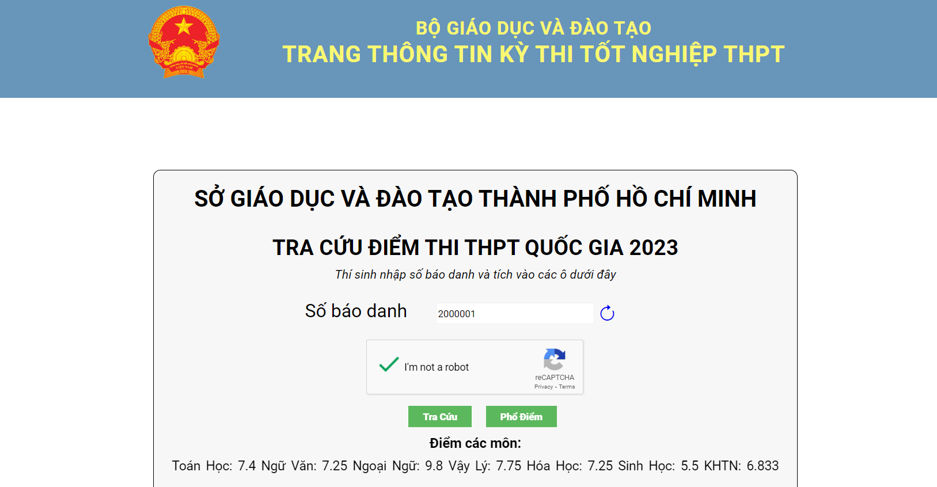
Result

Slide 10
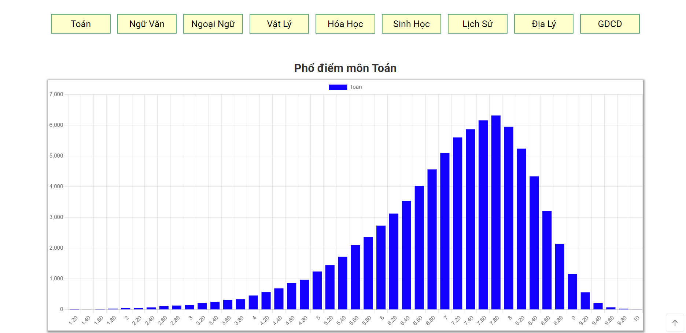
Result

Slide 11
Result
Less talking Start Working

Slide 12
THANKS!
Do you have any questions?

